Slide 1
QF602: Derivatives
Lecture 8:
Structure Notes

Slide 2
Equity Structured Notes
Equity structured notes became very popular at the end of the 1990s; they were issued by banks in response to their clients’ investment needs.
Equity notes are usually not used for hedging purposes.
They are mainly driven by yield enhancement.
Typical clients are treasury managers of large corporations and non-bank financial institutions.

Slide 3
Equity Structured Notes
Consider the following situation:
A client has $100 to invest for 1 year.
The current risk-free rate is 2%.
The client wants to achieve the expected return of 5%.
The client want to have 100% principal guaranteed, in other words, the investment still worth at least $100 at the end of the investment period.
The client is willing to give up the 2% of interest in order to achieve the expected return of 5%.
One way to achieve that is to use the 2% of interest to purchase an option which pays 5% if certain events happen in the future.

Slide 4
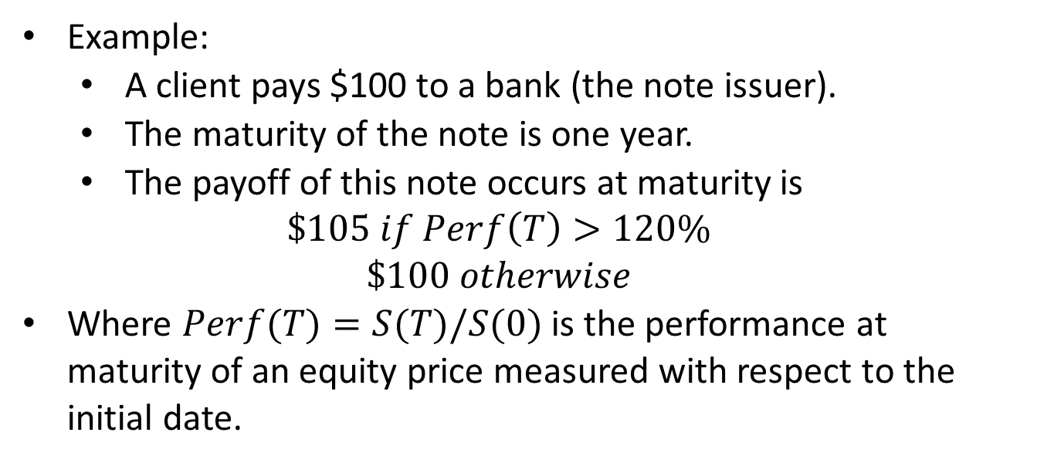
Equity Structured Notes
Example:
A client pays $100 to a bank (the note issuer).
The maturity of the note is one year.
The payoff of this note occurs at maturity is
$$\$105 if Perf\left(T\right)>120\%$$
$$\$100 otherwise$$
Where $Perf(T)=S(T)/S(0)$is the performance at maturity of an equity price measured with respect to the initial date.

Slide 5
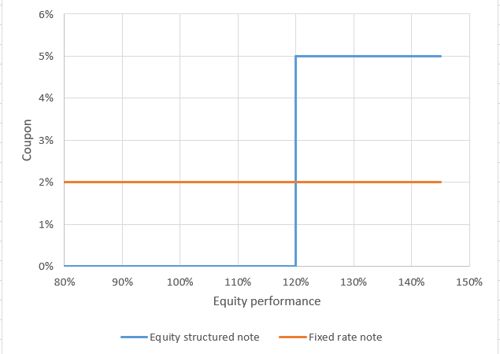
Equity Structured Notes
The diagram below compares the coupons of the equity note and a fixed rate note.
In order to achieve a higher return, the client is willing to give up the coupon if the performance is less than 120%.

Slide 6
Equity Structured Notes
In essence, an equity structured note is most often composed of a fixed-income part that guarantees full or part of the notional, and an option component that gives the holder a variable payoff based on a specific equity underlying.
In our example, the fixed income part is a zero-coupon bond issued by the bank. It is based on the risk free rate as well as the credit worthiness of the issuer (the bank). The riskier (lower credit worthiness) the bank is, the higher interest rate the bank needs to pay. Say in this example, the bank is not risk free and it needs to pay extra 3% due to its credit worthiness.

Slide 7
Equity Structured Notes
The diagram below shows how the structured note is priced.
Potential Coupon
Option Premium
100% Capital
ZC price

Slide 8
Equity Structured Notes
From the structurer’s point of view, the structure of the note is defined according to the different market parameters on the initial date.
To guarantee a payment at maturity equal to 100% of the invested capital, the structurer must price a one year zero coupon bond paying 100% based on the 2%+3%=5%.
It’s price is equal to 100% x exp(-5%) = 95.12.
Now the structurer has 100-95.12=4.88 to spend on an equity option.
Note that the guaranteed capital is only guaranteed per se by the issuer.

Slide 9
Equity Structured Notes
Also, investing in a note does not mean that the investment is safe all the time up to the maturity date.
The invested capital is locked during the entire life of the note. If the investor has liquidity issues and wishes to redeem their equity note at any point in time, the issue has to provide them with a bid price – which could be lower than the 100% invest notional.
Indeed, the price of the note at the time t is equal to the price of the option part plus the price of the fixed-income component.
These values vary as the different market parameters fluctuate over time.

Slide 10
Relationship of the desks
Investor pays $100 to the Structuring desk to purchase an equity note with maturity 1 year.
Structuring deposits $95.12 to the Funding desk for 1 year @ 5%.
Structuring purchases an equity option from the Trading desk.
Structuring receives $100 from Funding at maturity.
Trading pays the coupon to Structuring depends on the performance of the equity.
Structuring pays the investor $100 plus the coupon.
Funding Desk
4
2
Trading Desk
3
Structuring Desk
1
Investor
5
6

Slide 11
Credit Linked Note
Instead of having exposure to equity performance, one can choose to earn extra yield with bonds.
For example, an investor wants to earn an extra yield from a corporate bond but he doesn’t have access to the bond due to many reasons.
CLN is a structure such that it facilitates the investment requirement.
Banks usually have wider access to those instruments then investors. CLN allows banks to earn a spread and investors to fulfil their investment requirement.
This is called a fully funded structure. The bank has no credit risk as all the credit risk is taken by the investor.

Slide 12
Credit Linked Note
Investor pays the notional to the Structuring desk to purchase a CLN with maturity T.
Structuring purchases a bond from the market.
The bond pays the coupons to Structuring periodically and the notional at the maturity.
Structuring pays coupons to the investor periodically and the notional at the maturity.
Bond
2
Structuring Desk
1
Investor
QF602
3
4
12
QF602
12

Slide 13
Unfunded Structure
Consider the case that an investor wants to earn an extra yield by buying a bond. Instead of paying the full notional upfront, the investor borrows the money from the bank.
The investor will only do that if the cost to borrow the money is less than the coupons from the bond.
In other words, the investor and the bank are entered into a swap contract to exchange cashflows.
The investor receives the coupons from the bond and the bank receives the borrow cost from the investor.
However, if the bond defaults then the bank may suffer a loss since the investor has no collateral posted to the bank.

Slide 14
Unfunded Structure
Investor enters into a swap contract with the bank in which investor pays borrowing costs and receives bond coupons periodically.
Structuring borrows the notional from the funding desk and pays the borrowing costs periodically.
Structuring purchases a bond from the market.
The bond pays coupon to structuring periodically and the notional at the maturity.
Structuring pays back the notional to funding at the maturity.
Funding Desk
5
2
Bond
3
Structuring Desk
1
Investor
4

Slide 15
Unfunded Structure
We can see that when the bond defaults, the structuring desk suffers the loss as it has an obligation to pay back the full notional to the funding desk.
To mitigate the credit risk of the bond, the structuring desk may enter into some form of margin requirement to the investor and have a trigger to unwind the structure when the bond is deemed risky.
Funding Desk
5
2
Bond
3
Structuring Desk
1
Investor
4

Slide 16
Leveraged Bond Note
This is somewhere between the fully funded and unfunded structure.
For example, the investor gives 100m to the bank and at the same time borrow another 200m from the bank in order to purchase 300m of a bond.
The investor needs to pay the borrow cost for the borrowed amount, i.e. 200m, periodically.
The structuring desk receives coupon from the total 300m and then pass to the investor. In order words, the investor has 2 times leverage.
We can see that if the bond value drops by more than 33% then the bank suffers a loss.
Funding Desk
5
2
Bond
3
Structuring Desk
1
Investor
4

Slide 17
Callable Note
In order to get an extra yield, investors can also sell the right to the issuer (i.e. the bank) to cancel the note at some specific time. In other words, the bank returns the full notional amount to the investor.
Since this is an option own by the bank, the bank must pay high coupon to the investor.
For example:
The current 10y swap rate is 2.5%.
Instead of receiving a floating interest rate, investor can choose to receive 2.5% fixed for the whole maturity.
However, if the investor is willing to give the right of the bank to returns the money at a few specific times in the future, the investor can earn higher interest rate, say, 3%.
In other words, the option to cancel is worth 0.5%.

Slide 18
Callable Note
From the bank’s perspective, the option to cancel the note can be viewed as a Bermudan option to get into a pay fixed interest rate swap at 2.5%.
The option is called Bermudan swaption.
For example:
For US interest swap, the floating payment frequency is 3m, the fixed payment frequency is 6m

